Slide 1

Web Content Management
m o v i n g b u s i n e s s t o t h e w e b TM

Slide 2
TeamSite Environment

Slide 3
TeamSite Environment
Workareas
Staging Area
Edition
Notes:
The structural components of the TeamSite system consists of workareas, a staging area, editions, and branches.
In the TeamSite environment, content is developed and maintained in individual workareas. The workarea contains a virtual copy of the entire website.
Content in workareas are then submitted to a shared staging area. The contents of the staging area are published in an edition. Editions can be deployed to the live website.
TeamSite branches contain private workareas, which contain complete virtual copies of the website. This includes staging areas where contributors integrate their work, and editions which are read-only snapshots of the website at various points in its development.

Slide 4
TeamSite Environment: Workareas
TeamSite lets users work on complete virtual copies of the website in private workareas.
This allows each user to work in the context of the entire website, without interrupting the work of others.
User 1
User 2
User 3
Workareas

Slide 5
TeamSite Environment: Workareas
A workarea is a virtual copy of the entire website.
Files can be modified without affecting the work of other users or the actual website.
Enables large-scale experimentation - users can make far-reaching changes in a workarea without having to worry about inconveniencing other users.
writeable
changing content
Workareas
Notes:
Each workarea contains a virtual copy of the entire website, which may be modified in any way without affecting the work of other contributors. Users who have access to a workarea may modify files within that workarea and view their changes within the context of the entire website before integrating their work with that of other contributors. Users can lock files in a workarea, eliminating the possibility of conflicting edits.
All changes that are made to files in a workarea are kept completely separate from other workareas and the staging area until the user chooses to promote the changes to the staging area. Within a workarea, users may add, edit, or delete files, or revert to older versions of files without affecting other users.

Slide 6
TeamSite Environment: Staging Area
The staging area is a common area where changes from the workareas are integrated and shared.
Contributors submit changes
from their workareas to the
staging area.
They also synchronize their
Workareas against the staging area to keep in synch with changes made by other members of the team.
Workareas
Staging Area

Slide 7
TeamSite Environment: Staging Area
Files from workareas are integrated and tested.
Files in the staging area cannot be edited.
Changing content of the staging area does not affect the active website.
Large teams can coordinate and integrate their efforts.
Staging Area
not directly writeable
changing content
Workareas
Notes:
Users submit files from their workareas to the staging area to integrate their work with other contributors, and test the integrity of the resulting website. Because the staging area is an integrated component of the system, conflicts are easily identified and different versions of the same file can be merged, rather than overwritten.

Slide 8
TeamSite Environment: Editions
An edition is a read-only archive of the website.
At any time, the team
can take a “snapshot”
of the staging area and
publish it as an edition.
Editions
Staging Area
Workareas

Slide 9
TeamSite Environment: Editions
An edition is a read-only copy of the contents of the staging area at the time the edition was published.
Usually created when the staging area is well-integrated.
Can be used as a reference point or for deployment.
8/31/99
8/24/99
8/17/99
8/10/99
read-only
unchanging content
Editions
Staging Area
Workareas
Notes:
Editions are read-only snapshots of the entire website taken at sequential points in its development. Contributors can create new editions any time they feel their work is well integrated, or any time they want to create an update to the website for reference or deployment. Each edition is a fully-functional version of the website, so that users may see the deployment of the website over time and compare it with current work.

Slide 10
TeamSite Environment: Branches
Branches are the framework for the team’s development efforts.
Each branch contains the team’s workareas, a staging area,
and all published editions.
Branches may be related to each other (alternate versions of a website) or they may be completely independent (Internet vs. Intranet websites).
Initial Edition
Edition 1
Edition 2
Edition 3
Workareas
Staging Area
New Edition
Notes:
TeamSite provides branches for different paths of development for a website. Branches may be related to each other (e.g. alternate language versions of the same website, or site variations such as Java/no Java), or they may be completely independent. Each branch contains all the content for a website.
A single branch contains archived copies of the website as editions, a staging area for content integration, and individual workareas where users may develop content without disturbing one another. Branches facilitate distributed workflow because they allow separate teams to work independently on different projects. Because all branches are located on the same TeamSite server, it is easy for one team to incorporate the work of another team into their project.

Slide 11
TeamSite Environment: Sub-Branches
Each branch contains workareas, a staging area, editions, and may contain sub-branches.
Editions
Staging Area
Workareas
Notes:
Sub-branches are useful in that they allow teams to keep alternate paths of development separate from each other. Content can be easily shared and synchronized across branches and sub-branches. Users may work on one branch or on several, and the number of branches on a system is not limited.
A sub-branch is a branch subordinate to another branch.
A sub-branch may be rooted in its parent branch (e.g. an alternate version of the website, such as a redesign project).
A sub-branch may be created for a completely separate project.
Each sub-branch contains its own unique workarea, staging area and generates its own editions, and may contain sub-branches of its own.
Editions published on a sub-branch can be integrated back into work on the higher branch, or released as stand-alone websites.

Slide 12
TeamSite Production Model
Deploy
Production Server
Edition 4
Edition 3
Edition 2
Edition 1
TeamSite Server
Editions
Publish
Staging Area
Branch
Get Latest
Submit
Workareas
Edit
Upload
Client
Local Computer
Notes:
TeamSite branches contain private workareas, which contain complete virtual copies of the website; staging areas, where contributors integrate their work; and editions, which are read-only snapshots of the website at various points in its development.
Each area contains a virtual copy of the entire website. Content is submitted from workareas to the staging area, and the staging area is then published as an edition. Editions may then be deployed to your production server.

Slide 13
TeamSite Interface

Slide 14
User Pre-requisites
  Familiarity with basic operations such as opening and closing files
  Familiarity with the World Wide Web or your company’s intranet
  Experience using a web browser and some knowledge of editing website files

Slide 15
Requirements for TeamSite Access
User Account on the TeamSite server provided by the TeamSite Administrator
Browser such as Netscape 4.04 or above or Internet Explorer 4.0 or above
Interwoven LaunchPad if you will be editing files through the TeamSite GUI
Access to the TeamSite server
Notes:
TeamSite features are not all supported on all browsers. For a complete list of features that are supported in each browser, refer to the Choosing a Browser section of the Getting Started chapter in the Using TeamSite manual.

Slide 16
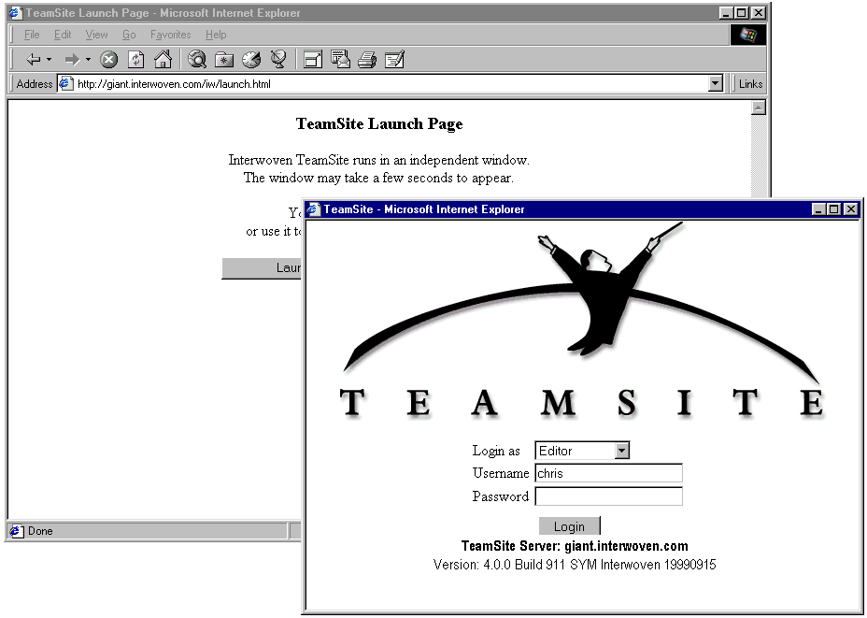
Logging into TeamSite
To get to this TeamSite login screen, type http://teasmsiteservername/iw or http://teasmsiteservername/iw/start.html. At the login screen, select your role, then enter your username and password.
Notes:
The TeamSite GUI is accessed through a browser. Specify the TeamSite server as a location. The /iw/ after the server name causes a login screen to appear. Select your role then enter your username and password. Roles will be discusses in detail later in this module.

Slide 17
The Graphical User Interface Features
Full access to all TeamSite functions
  View web files in TeamSite
  Edit web files in TeamSite
  Create Version website files in TeamSite
Access to general file management functions
  Create new files and directories
  Rename files
  Delete files and directories

Slide 18
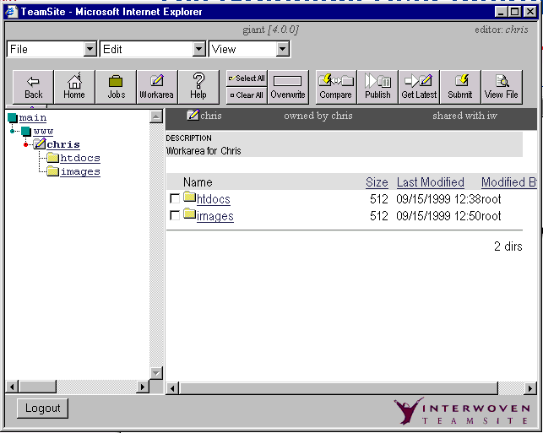
The Graphical User Interface
Your Servername
Your Role: Username
Menu Bar
Tool Bar
Button Bar
Description attached to workarea
The Work Window
The Navigation Window
Here are the key elements. Notice the Work Window and Navigation Window.
Notes:
The TeamSite GUI resembles Windows Explorer in that there are two display areas. The left pane is called the Navigation Window. It displays the hierarchy of directories and files. The hierarchical display can be expanded and collapsed by clicking on the + symbol. The right pane is called the Work Window. It contains the details of the file or directory selected in the Navigation Window. In the Work Window, you can navigate and work on files.

Slide 19
Navigating Through TeamSite
The Navigation Window contains the directory structure for TeamSite
To navigate, left-click the underlined name
Current location will be highlighted with a red dot
Use the Back button to return to a previous view
Navigation
Window
Notes:
Clicking the right mouse button will activate the browser functions, not the TeamSite functions.

Slide 20
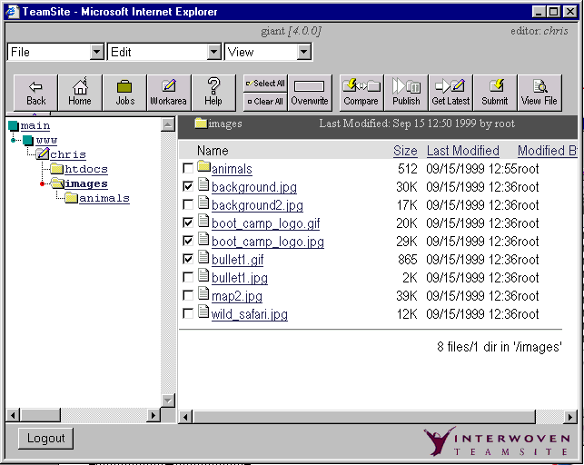
Navigating Through TeamSite
The Work Window contains a list of files and directories
Left-click links to preview the web page in a new browser window
Select files from this window to perform TeamSite actions
Use the checkboxes to select files for an action
Log out of TeamSite
Work
Window

Slide 21
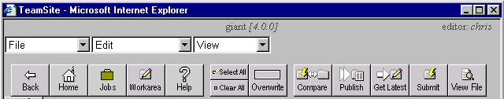
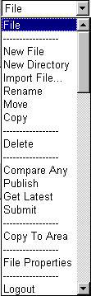
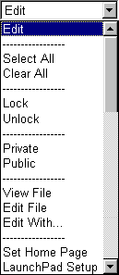

TeamSite GUI Tool Bar
The toolbar has three drop down menus: File, Edit, and View. The options that
are available depend on what your TeamSite role is.
Notes:
The TeamSite GUI has a button and a menu bar. The button bar contains the most frequently used commands. The menu-bar contains several drop-down menus that support file operations. The choices available from the drop-down menus vary depending on your role and what is selected in the work window.

Slide 22

SmartContext Editing
Select the file in the Work Window of the TeamSite GUI
Click the SmartContext Editing tab
A pull-out bar with buttons and menus appears
Allows you to Get Latest, Edit, Refresh, and Submit
Advanced pull-down menu
  Viewing file properties
  Configuring the SmartContext Editing tab
Color Bar (Indicates file status)
Pencil (Indicates that file has been modified)
Notes:
The following colors will appear to determine the files status:
Grey - You cannot modify (it is locked or you do not have permission).
Green - You can modify.
Yellow - You can modify this file but a newer version is in the staging area.
Red - You can modify this file but it is in conflict with the staging area.
To review the changes made, click the Refresh button on the pulled-out tab.

Slide 23
File System Interface
Manage your web content as if it were on a mounted drive on the network
Used primarily for file management functions
  Moving and copying files
  Importing new files
Can be used for editing files
Notes:
The File System Interface is another way to use TeamSite. You use TeamSite as a mounted network drive. The file system interface allows moving and copying files as well as file editing. It is useful for utilities such as link checkers and scripts you run that need to access and create files.
UNIX note: to use the File System Interface, you must install an SMB client.

Slide 24
File System Interface (cont.)
Accessing TeamSite
  Access TeamSite like any networked Windows server
In Windows
  Use Network Neighborhood to locate the TeamSite server
  Double-click the server name to open it
  Mount TeamSite server as networked drive
    Windows Explorer: Tools > Map Network Drive
    Select the drive letter
    Shared Directories list: locate the TeamSite server, double-click on IWServer

Slide 25
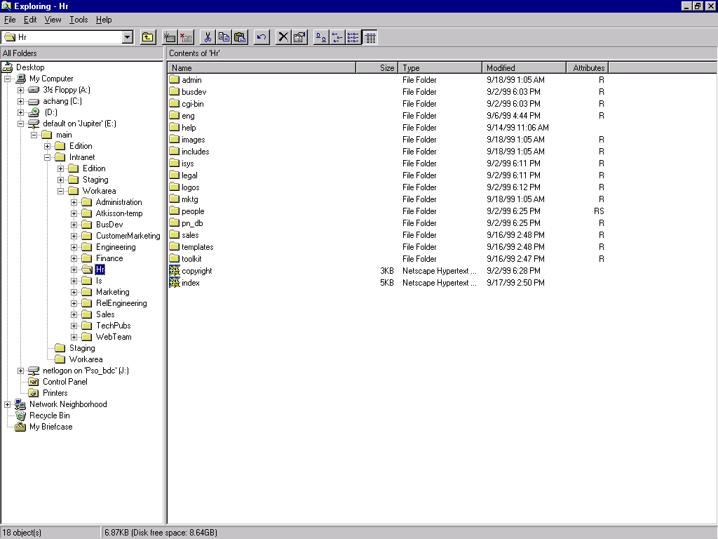
File System Interface

Slide 26
TeamSite User Role

Slide 27
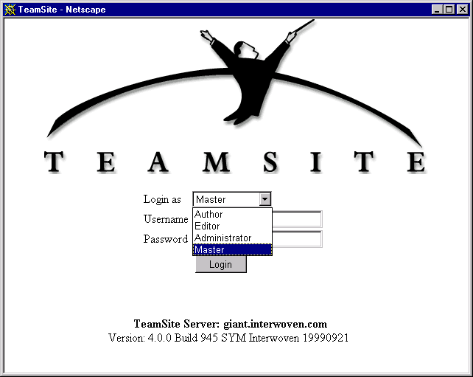
TeamSite User Roles Overview
There are four TeamSite roles: Author, Editor, Administrator, and Master.
Notes:
TeamSite has four different types of users: Authors, Editors, Administrators, or Masters. Each of these types has different abilities and levels of influence within the structure of TeamSite.

Slide 28
TeamSite Role: Author
Primary content creators of the website
Create and edit files for the site
Cannot delete files
Access TeamSite through the graphical user interface or the system interface
Work must go through an explicit approval step
Can edit files in a workarea but do not own the workarea
May have a Task list created by an Editor
Notes:
Content developer with limited access to TeamSite functions
Can access, create, and modify files through the Editor’s workarea
May work on tasks assigned by an Editor
Limited functionality

Slide 29
TeamSite Role: Editor
Own one or more workareas
Have all the capabilities of Authors
Can delete files
Can submit completed files to the staging area
Can publish editions (though this can be restricted)
Can assign work to Authors
Notes:
Owner of a workarea or areas
Assign work to Authors
Can publish editions (although this capability can be restricted)
Able to submit files to the staging area
Some companies may choose to have all their users as Editors

Slide 30
Author/Editor Workflow
Authors add and/or edit files contained within an Editor’s workarea
Editor’s review files in their workarea then submit the files to the staging area

Slide 31
TeamSite Role: Administrator
Own branches
Has the capabilities of Authors and Editors
Can publish a website
Has extended capabilities and special access privileges on his own branch
Manages project workflow by creating workareas and sub-branches on his branch
Typically is a project manager or webmaster who oversees the development of content on his own branch
Notes:
Has ability to deploy editions to production
May have a few Administrators per site
Can create sub branches under branches

Slide 32
TeamSite Role: Master
Owns the main branch, from which all sub-branches are created
Has authority over the entire TeamSite server
Organizes the structure of the TeamSite system
Has all the capabilities of Authors, Editors and Administrators on any branch (e.g., create, edit, delete, submit, and publish)
Is generally involved in the installation of TeamSite, and can reconfigure TeamSite on a system-wide basis
Notes:
Owner of the main branch
Responsible for the entire website
Organizes the structure of a TeamSite installation
Can perform all functions on all branches

Slide 33
Managing Files

Slide 34
Basic File Management
Preview Web Content
Edit Web Content (that you have permissions for)
Import Files
Create, Delete and Rename Files and Directories
View File Properties
Set Home Page
Lock Files
Merge Files

Slide 35
Advanced Features

Slide 36
Advanced Features
How to Collaborate in TeamSite
  Updating your work
  Comparing and submitting your work
  Deleting files from the staging area
Comparing, Viewing History, and Reverting Back to a Previous Version
Merging Files
Publishing editions

Slide 37
Viewing File History
Files are versioned every time they are submitted to the staging area
File versions have unique revision IDs
Old versions can be accessed or reverted to at any time

Slide 38
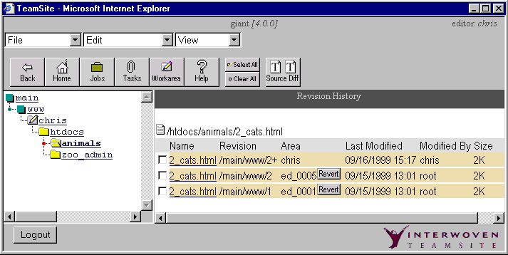
Viewing File History (continued)
View the history of a file by selecting its checkbox, then selecting View > History
  File Version IDs have the format:
  branchpath /versionnumber

Slide 39
Viewing File History (continued)
  File History includes the modification date, comments attached at the time of submission, username of the person who submitted the file, and the size of the file
  A file modified in a workarea but not submitted to the staging area shows version with a + sign.

Slide 40
TeamSite
Workflow Overview

Slide 41
TeamSite Workflow Overview
Workflow is the set of actions that takes content from development to production
  Migration of content from development, to test, to staging, to production
  Content approval
  Task-based workflow
Workflow automates and enforces standard production processes
  Automated, configurable approval processes
  Enforced production rules
Notes:
Workflow may be configured to stop short of production or to start halfway through development.

Slide 42
Example: Author Assignment Workflow
Within one workarea, an Editor can assign work to an Author and approve the Author’s work

Slide 43
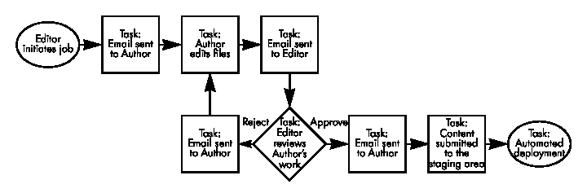
Workflow Model

Slide 44
Definitions
Workflow Model: A general configuration that can be used/initiated repeatedly.
  Configured by a TeamSite Master/Administrator or by TeamSite consultants
Job: A workflow model initiated by a TeamSite user that contains a series of user/external Tasks
Task: A unit of work performed by a user or an external program

Slide 45
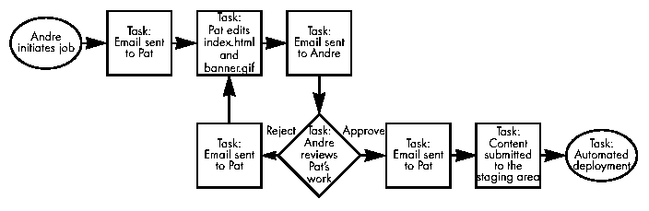
Sample of a Job

Slide 46
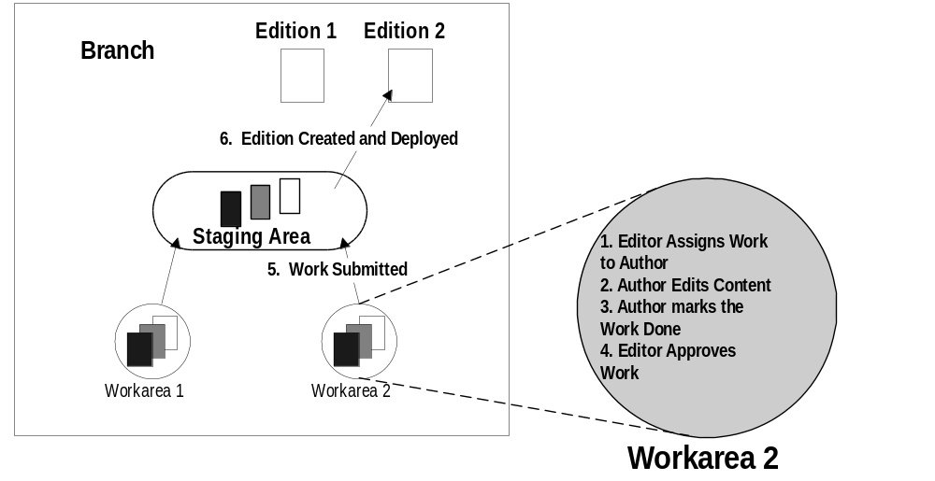
Example: Author/Editor Workflow

Slide 47
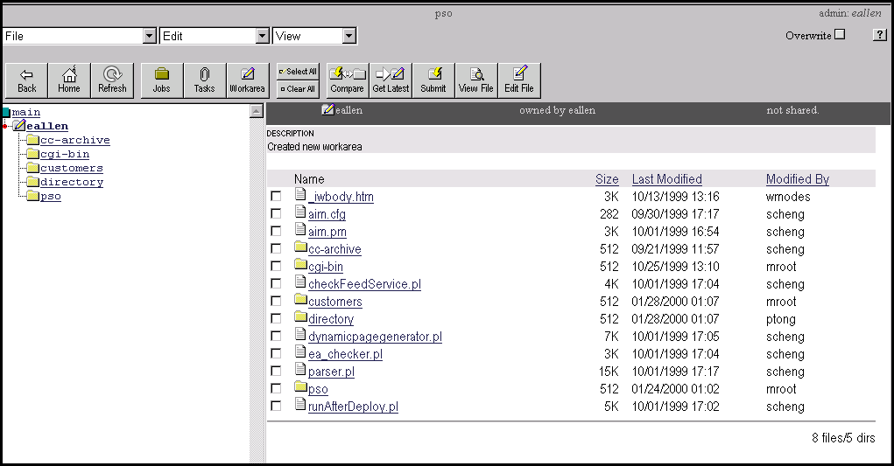
Click the Jobs button

Slide 48
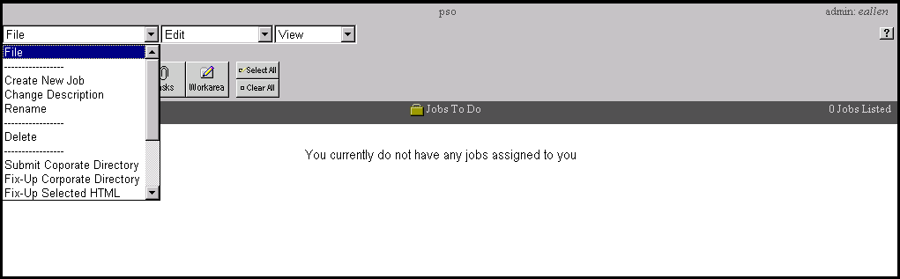
Click File > Create New Job

Slide 49
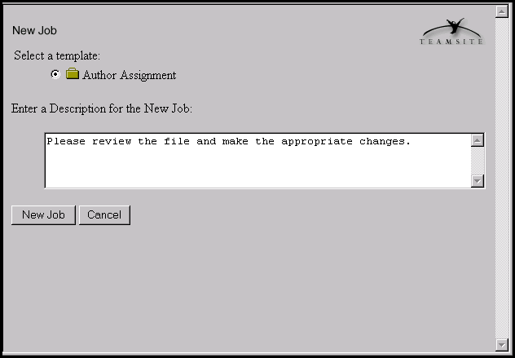
Enter Description
Notes:
Depending on the installation, there could be more than just the Author Assignment template.

Slide 50
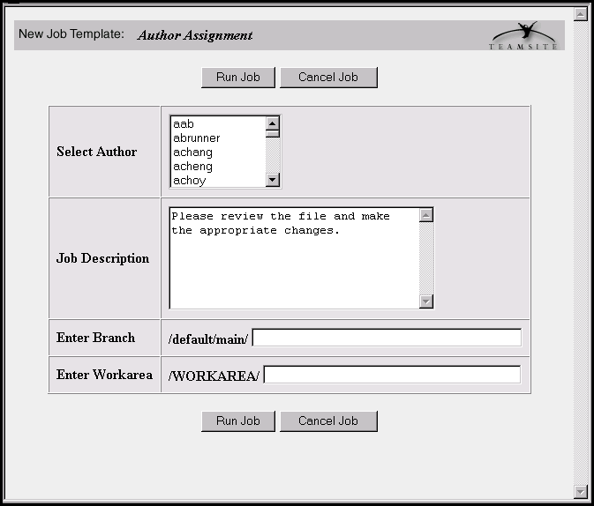
Specify Author Assignment

Slide 51
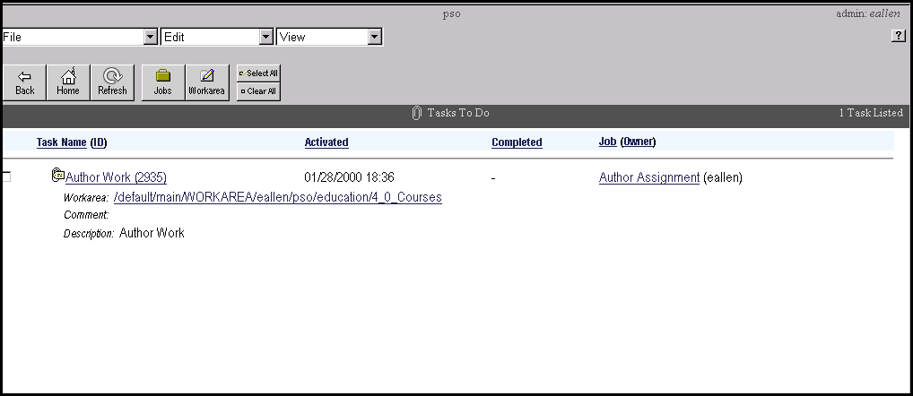
Click on the Job ID

Slide 52
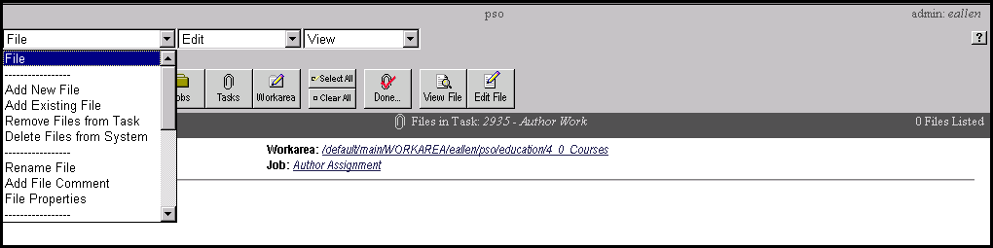
Click File > Add Existing File

Slide 53
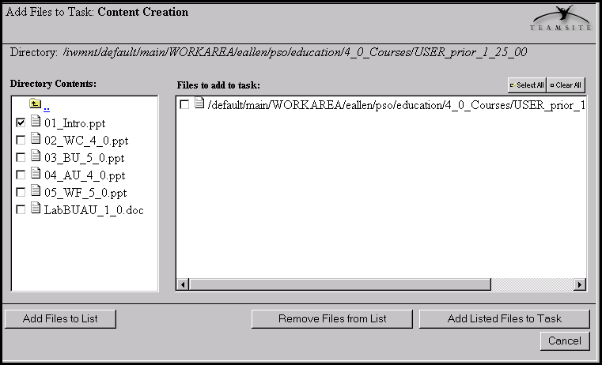
Add Files

Slide 54
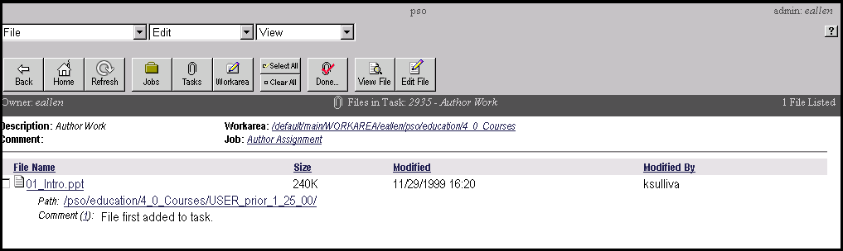
View Files in the Task

Slide 55
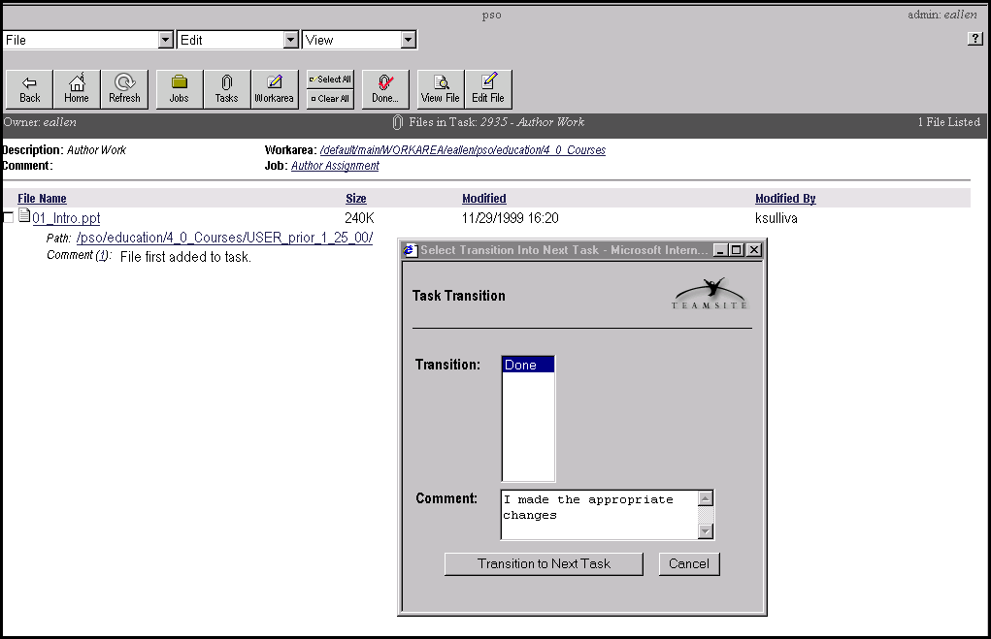
Mark Task as Done

Slide 56
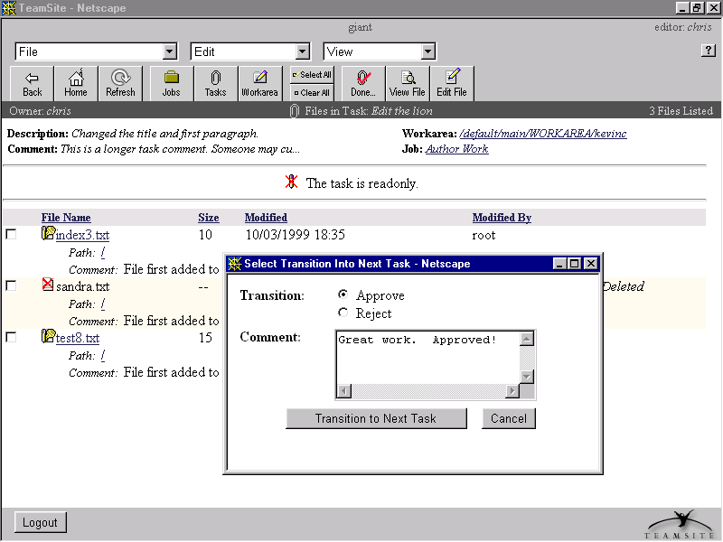
Complete Task

Slide 57
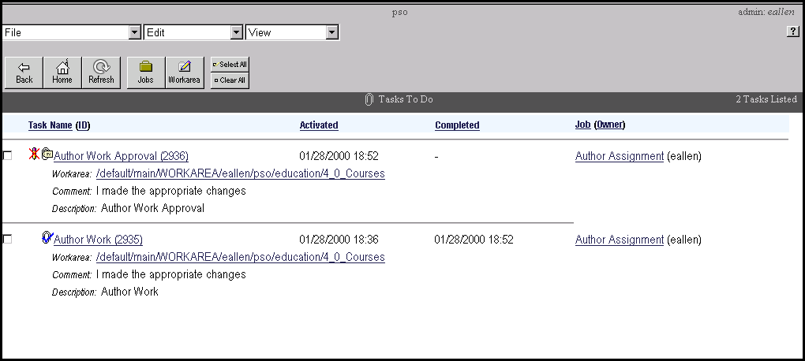
View Task List

Slide 58
TeamSite
Templating Overview

Slide 59
The TeamSite Templating Solution
Simple process
  A content contributor (any user) fills out a web form
  The information in the form is stored as data
  The data can be presented in one or more pre-defined HTML pages
Enables centralized administration of site and page design
  Provides for consistent styles, fonts, colors, etc.
Data is stored in one place and presented in one or more ways
  This is done by generating one or more HTML files based on the data
No need for content contributors to use HTML editors or other web development tools
  Simple TeamSite interface is the only tool required

Slide 60
The TeamSite Templating Solution (cont)
Process for content deployment using TeamSite Templating
  Content contributor fills out a simple web-based form
    Form is pre-defined by administrator
  Developer or other person (manager, QA, etc.) can preview data with multiple presentation templates
    No HTML knowledge required here--everything is done through the TeamSite GUI
  One or more HTML files are generated based on the data filled in on the form
    Easy process also accomplished from the TeamSite GUI
  TeamSite Workflow can be integrated to ensure proper business processes are followed

Slide 61
The TeamSite Templating Solution (cont)
Same data can be re-used in modified or new HTML files
  If a presentation template changes
    Example: marketing decides to change the background colors for a press release
    Press release data does not have to be re-entered
    Simply regenerate the page using old data and new presentation template
  If a new presentation template is created
    Example: a page exists that presents Product data by category
    Someone wants to use the same data from the product catalog to list the products by name on a separate page
    Simply create a new presentation template and generate a new page using existing data

Slide 62

Organizational Models: Examples
1 top level/multiple sub-levels
Corporate Templates
HR
Sales
Production

Slide 63
Organizational Models: Examples
Multiple top levels/multiple sub-levels
Internet
Auction
Careers
PR
Intranet
deptInfo
Weather

Slide 64
Categories
Categories are the top levels of template organization
Internet
Auction
These are Categories
Careers
PR
Intranet
deptInfo
Weather

Slide 65
Types
Types (or data types) are the sub-Levels of template organization
Internet
Auction
These are Types
Careers
PR

Slide 66
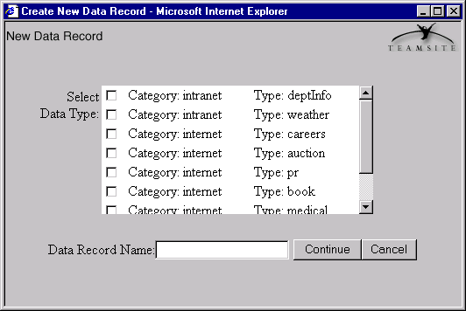
How Categories and Types are Used
Notes:
This dialog is displayed when a user selects File > New Data Record.
When users begin to enter data for a TeamSite template, they are presented with the GUI shown above. As you can see, categories and types are used to organize the template data. The category and type that is selected by the user will determine which form is used for data entry.
In reality, the categories and types are actually directories in the workarea where data and other template information are stored. You will learn more about this later on in the course.

Slide 67
Using TeamSite
Templating

Slide 68
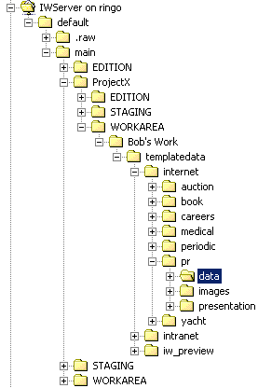
TeamSite Templating Directories
A templatedata directory must exist in each templating-enabled workarea
Each category is stored as a subdirectory in templatedata
Each category directory contains subdirectories for each template data type
The templatedata directory tree
Notes:
The directories and files in templatedata are created when a new TeamSite Templating site is installed and configured.

Slide 69
TeamSite Templating Files
DCT: Data Capture Template
  Defines the form that is filled in to create a new data content record
  Stored as datacapture.cfg in template data type directory
DCR: Data Content Record
  Created by filling in a DCT
  Stored with no specific extension in data subdirectory under the template data type directory
IPT: Interwoven Presentation Template
  Defines the appearance of the displayed data
  Stored in presentation subdirectory under the template data type directory with a .tpl extension
The "pr" template type's directory tree

Slide 70
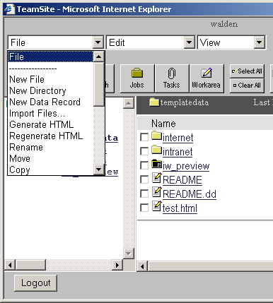
The TeamSite Templating Interface
The standard TeamSite user interface is enhanced when TeamSite Templating is installed
The file and edit menus have new features:
  File menu
    New Data Record
    Generate HTML
    Regenerate HTML
    Delete Data Record
  Edit menu
    Edit Data Record

Slide 71
Creating Data Content Records:1
To create a new data content record:
  Select a template category and type
  Enter the data into the capture template form
  Preview the data
  Save the data content record
Start with File > New Data Record

Slide 72
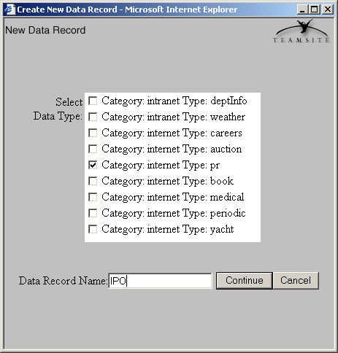
Creating Data Content Records: 2
Select a category and type of data record to create
Next, give the new DCR a name
  Remember that this will become an XML file name
  You don't need any particular extension
  It will be saved in the template type's data directory
Click Continue

Slide 73
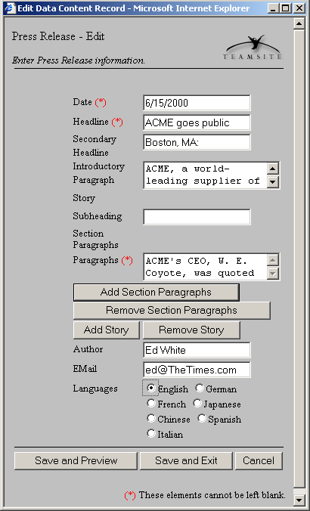
Creating Data Content Records: 3
Fill in the fields
  Items with a red asterisk (*) are required
Some sections are expandable
  These are replicants in the DCT XML
When finished:
  Use Save and Preview to see immediate example of published piece
  Use Save and Exit to finish data entry
Files are saved to the template type's data directory
Notes:
How the form gets built:
The data capture template for a templating data type is defined in its datacapture.cfg file. The XML coding in the DCT is rendered by the TeamSite Templating engine. Each element in the DCT creates a field in the form. If an element in the DCT has its required attribute set to t, then the field is marked as required. Replicant elements in the DCT create expandable fields on the form. We'll learn to edit and create DCTs in module 4.

Slide 74
Saved DCR
All DCRs for a template type are stored in that template type's data directory
The file is saved in text format as an XML file

Slide 75
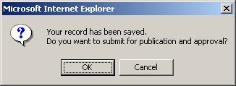
Submitting the DCR
After you save the DCR, TeamSite
Templating will prompt you to submit
for publication and approval
If a workflow has been defined, the DCR
can be sent for approval this way
If you select OK at this point, the DCR will be submitted for publication and approval
If you cancel, you can submit it later with the normal submit process
Notes:
Templating and Workflow
TeamSite Templating is designed to work with TeamSite workflow jobs.

Slide 76
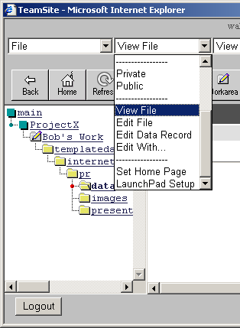
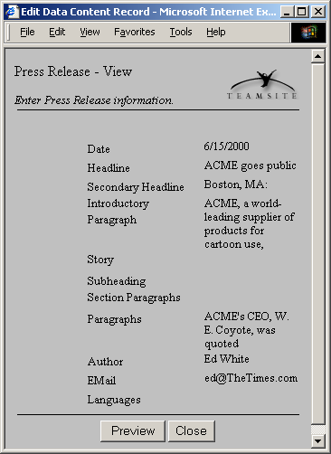
Previewing a DCR:1
You can preview a DCR using any of its assigned presentation templates
It's a good idea to preview prior to creating the HTML file to catch errors missed during data entry
If you catch an error, you can re-edit the DCR or delete it
To preview:
  Select the DCR
  Select Edit > View File
  Review the displayed generic version of the DCR
  Click the Preview button to preview with a presentation template

Slide 77
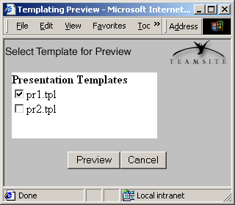
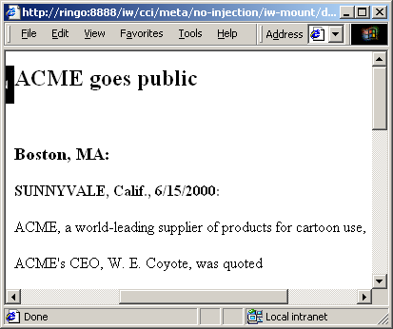
Previewing a DCR:2
Select the template you want to preview the DCR with
  More than one template could exist
  You can preview with any of them
Click the Preview button
  The preview will be displayed in your browser

Slide 78
Generating HTML
The final goal of the templating process is to create HTML content that is ready to publish
Once you have created a DCR you can create the final HTML document
This document can then be published to a web server
If the content changes, the DCR can be re-edited and a new HTML file regenerated very quickly
Much of the process of generating and regenerating HTML can be automated with scripts

Slide 79
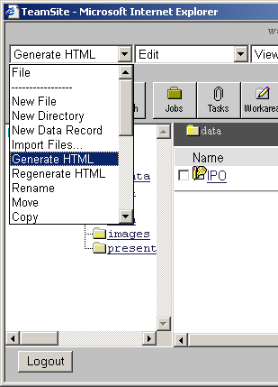
Generating HTML Files:1
Once you have a DCR and it is ready to publish, you can generate an HTML file
The HTML file is the DCR merged into the presentation template
To start the process, select FIle > Generate HTML
  There is a command line option to do this also, which we will look at later

Slide 80
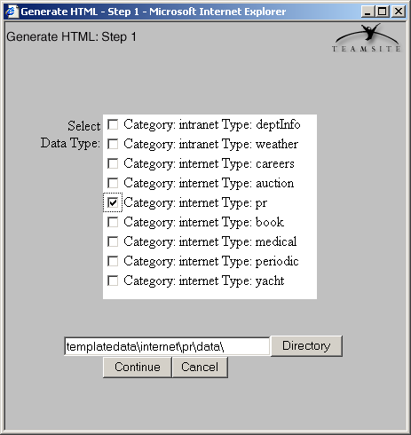
Generating HTML Files:2
Select the template type for which you want to generate HTML
Select a directory to place the new HTML file into
Click Continue

Slide 81
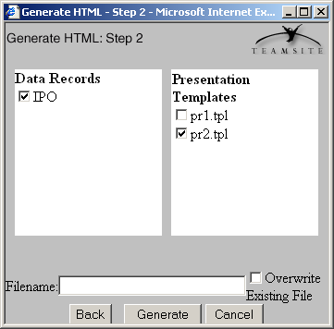
Generating HTML Files:3
Select the DCR for which you want to generate HTML
Select the presentation template to use to format the HTML
  When you select the template, a review will immediately appear--check it, then close it
Enter a file name for the new HTML file
Click Generate
The new HTML file is written into the selected directory
Notes:
TeamSite Templating will automatically add an extension--.html be default--to whatever name you enter in the filename field. Even if you put your own extension on the filename, the standard extension will still be added. This could result in an incorrect filename.

